Slide 1
RAG End2End Code
2조 : 김민창

Slide 2
Summary
>
1
BART
Denoising Sequence-to-Sequence Pre-training for Natural Language Generation, Translation, and Comprehension
2
What is ODQA
3
Model Architecture of the Retriever Part of RAG
Retrieval-Augmented Language Model Pre-Training
Dense Passage Retrieval for Open-Domain Question Answering
4
Model Architecture of the Generator Part of RAG
Retrieval-Augmented Generation for Knowledge-Intensive NLP Tasks
5
Comparison of Rag & Rag end2end
Improving the Domain Adaptation of Retrieval Augmented Generation (RAG) Models for Open Domain Question Answering
6
LoRA
Low-Rank Adaptation of Large Language Models

Slide 3
BERT vs BART
>
Bert
Bart
Bert는 Encoder 구조
텍스트를 이해하고, 그 내용에 기반하여 다른 작업을 수행하는 데 사용
MLM과 NSP를 통해 사전 학습
Bidirectional, 즉 주어진 단어의 앞뒤 문맥을 모두 보고 그 단어의 표현을 학습
Seq2seq Model (Encoder-Decoder)
주어진 텍스트에 기반하여 새로운 텍스트를 생성하는 데 사용
Denoising autoencoder로 사전 학습
Encoder에서는 Bidirectional, Decoder에서는 auto-regressive방식을 사용

Slide 4
BART
>
Denoising Sequence-to-Sequence Pre-training for Natural Language Generation, Translation, and Comprehension
1. Token Masking
2. Token Deletion
Train to predict where tokens are lost
3. Text Infilling
Train to predict how many tokens are lost from a span of time
4. Sentence Permutation
5. Document Rotation
Train to predict the beginning of a sentence
I like apples
Apples are so delicious
I [MASK]
Apples [MASK] are so delicious

Slide 5
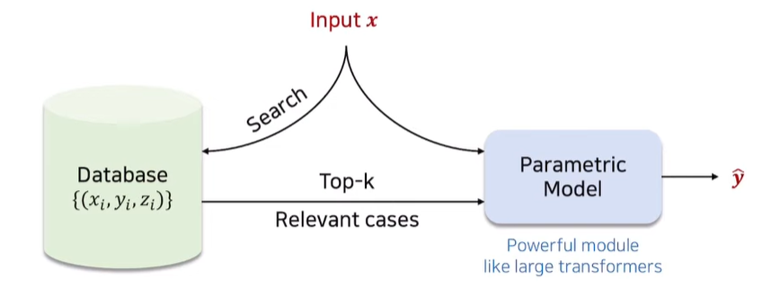
What is ODQA
>
Question이 주어졌을 때 Knowledge Base 에서 Retriever가 불러온 관련된 Passage에서 Reader 가 Answer를 추론하는 Task
ODQA
KIT (Knowledge Intensive Task)
https://www.youtube.com/watch?v=gtOdvAQk6YU&t=2282s

Slide 6
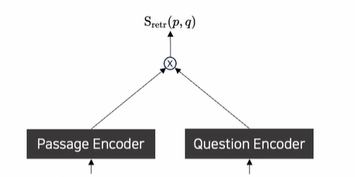
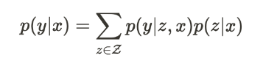
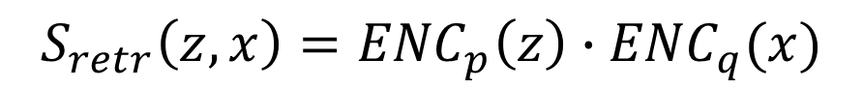
What is ODQA
>
Retriever
Quenstion과 관련된 Passage를 knowledge base에서 찾는 모델
$$S_{retr}\left(z,x\right)={ENC}_{p}\left(z\right)∙{ENC}_{q}(x)$$
Passage and Question Inner product produced by Retriever
Weight of Passage when calculating answer
Higher score = The passage is important for inferring the answer
Question이 Input일 때 사용할 Passage의 Liklihood를 최대화
https://www.youtube.com/watch?v=gtOdvAQk6YU&t=2282s

Slide 7
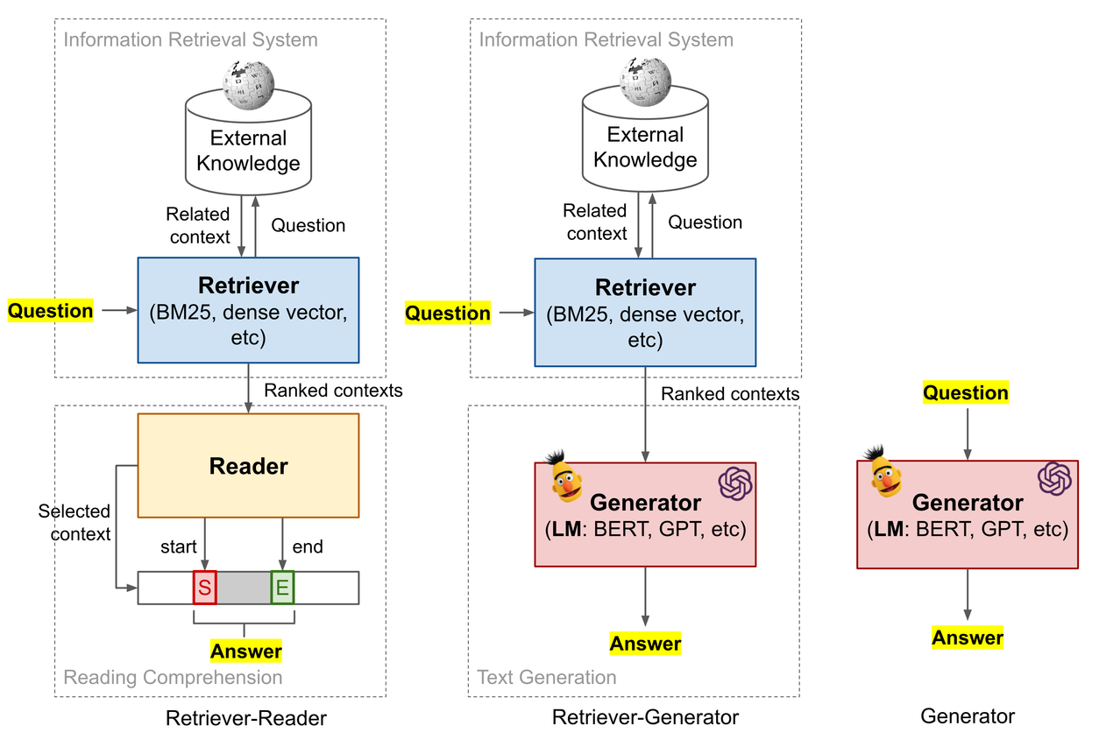
What is ODQA
>
1) Extraction based prediction
Passage 에서 Answer 후보가 될 수 있는 span을 찾는 모델
2) Generation based prediction
Passage와 Question을 입력하여 Answer를 생성하는 모델
$S_{read}\left(y | z,x\right)=Bert\left(z,x\right)$ or $Bart(z,x)$
Answer score for each span as calculated by Reader
Select the final Answer by calculating and marginalize each passage
Question과 Passage가 Input일 때 Answer의 Liklihood를 최대화

Slide 8
What is ODQA
>
Performing a KIT by changing the reader to a generator
Train a retriever too
DRQA
Chen et al, 2017
ORQA
Lee et al,
2019
REALM
Guu et al, 2019
RAG
Lewis et al, 2021
Look up the answer in an external knowledge database
Train a Retriever-Reader from end2end

Slide 9
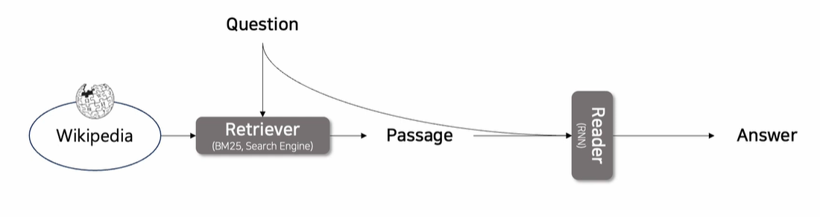
DRQA
>
Reading Wikipedia to Answer Open-domain Questions (2017)
Two Stage : Retriever + Reader approach
Readers train independently without training a retriever
Point ) Text를 어떻게 찾아낼 것인가?
Sparse Embedding vs Dense Embedding
https://www.youtube.com/watch?v=gtOdvAQk6YU&t=2282s

Slide 10
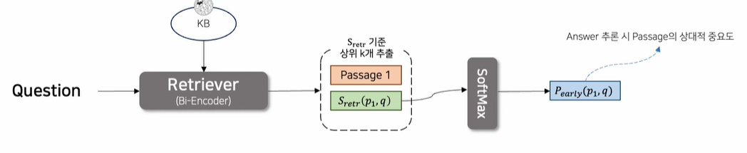
ORQA
>
Latent Retrieval for Weakly Supervised Open Domain Question Answering (2019)
Bi-Encoder proposal for Retriever part
Passage Encoder : Pretraining
Question Encoder : Pretraining & Finetuning
https://www.youtube.com/watch?v=gtOdvAQk6YU&t=2282s

Slide 11
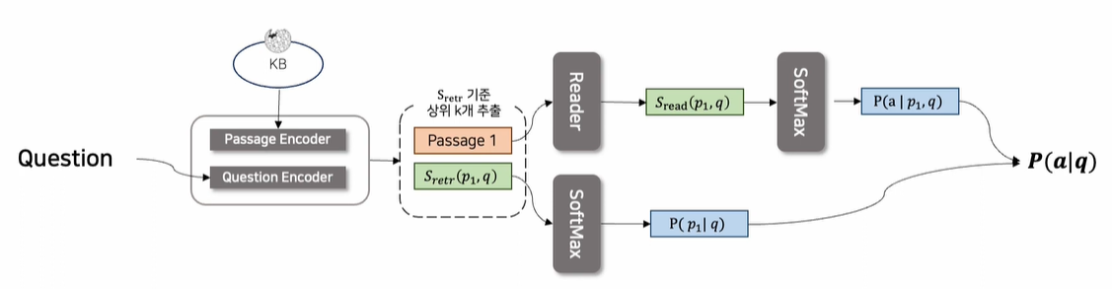
REALM
>
Retrieval-Augmented Language Model Pre-Training (2019)
Step 1) Query(x)를 넣어서 Retriever에 태워 Document(z)를 출력
All Knowledge corpus
Step 2) Query(x)와 Document(z)를 함께 사용하여 y값을 찾는 방식
Model Architecture
Nerual Knowledge Retriever (step1)
Knowledge-Augmented Encoder (step2)
Training Process
Unsupervised : Pretraining
Supervised : Finetuning
https://www.youtube.com/watch?v=gtOdvAQk6YU&t=2282s

Slide 12
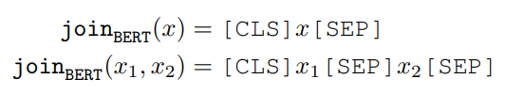
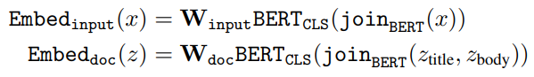
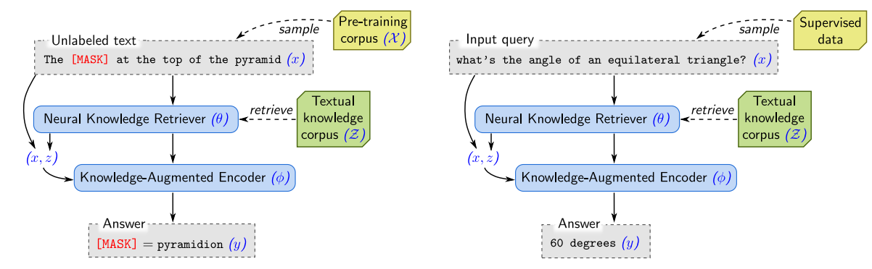
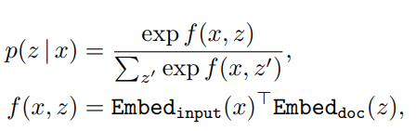
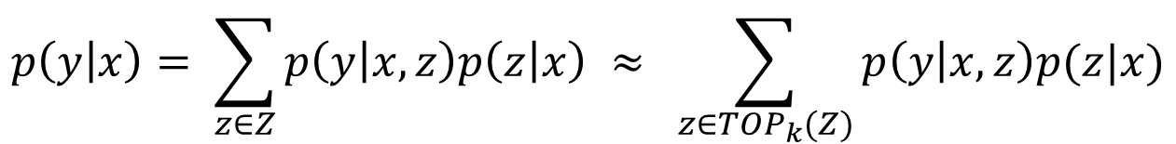
REALM
>
Retrieval-Augmented Language Model Pre-Training (2019)
$$p\left(y | x\right)= \sum_{z∈Z}{p\left(y | x,z\right)p\left(z | x\right)} ≈ \sum_{z∈{TOP}_{k}(Z)}{p\left(y | x,z\right)p(z|x)}$$
Nerual Knowledge Retriever
1) Bert style transformer
Maximum Inner Product Search
2) Embedding
3) Relevance score

Slide 13
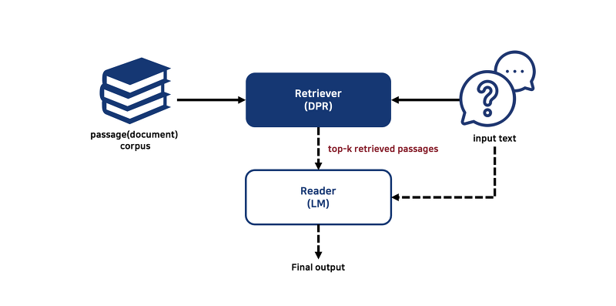
RAG
>
Retrieval-Augmented Generation for Knowledge-Intensive NLP Tasks

Slide 14
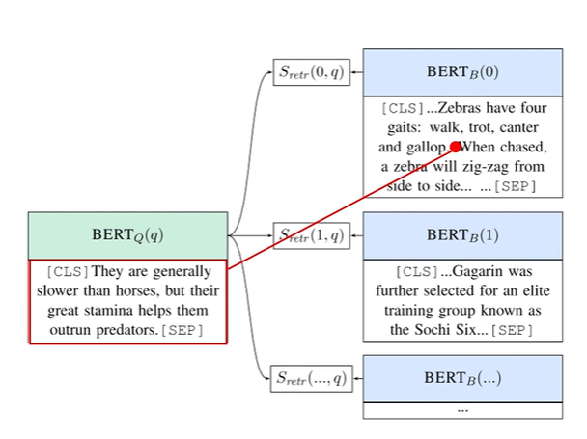
DPR
>
Dense Passage Retrieval for Open-Domain Question Answering (2020)
ICT Pretraining is computationally intensive
Not completely clear that regular sentences are good surrogates of questions
The context encoder is not fine-tuned (suboptimal representations)
Change the Pretraining method(Positive/Negative)
Provide the label for a question-document pair -> Supervised Pretraining
Apply Passage Encoder to all fingerprints -> FAISS Library
https://www.youtube.com/watch?v=u4GE0sloBQU&t=438s

Slide 15
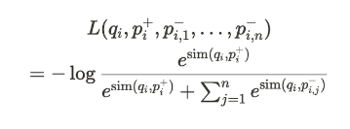
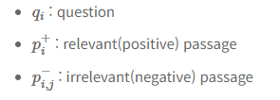
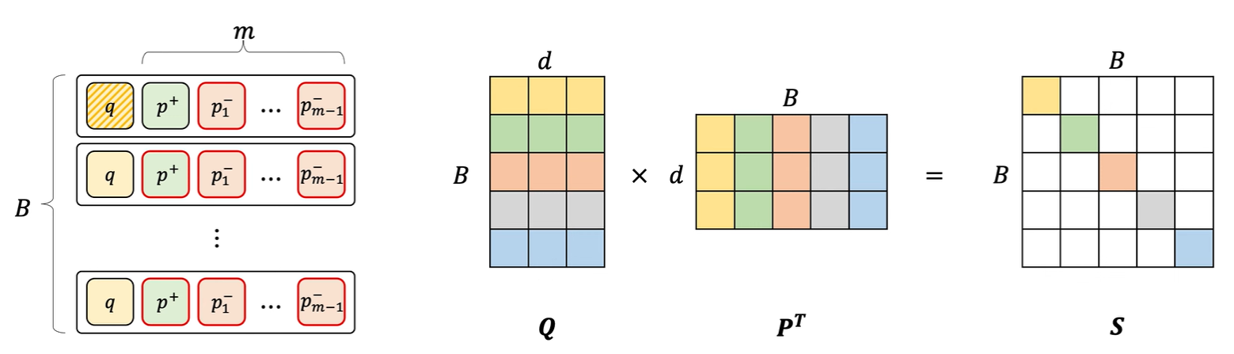
DPR
>
Dense Passage Retrieval for Open-Domain Question Answering (2020)
https://www.youtube.com/watch?v=u4GE0sloBQU&t=438s

Slide 16
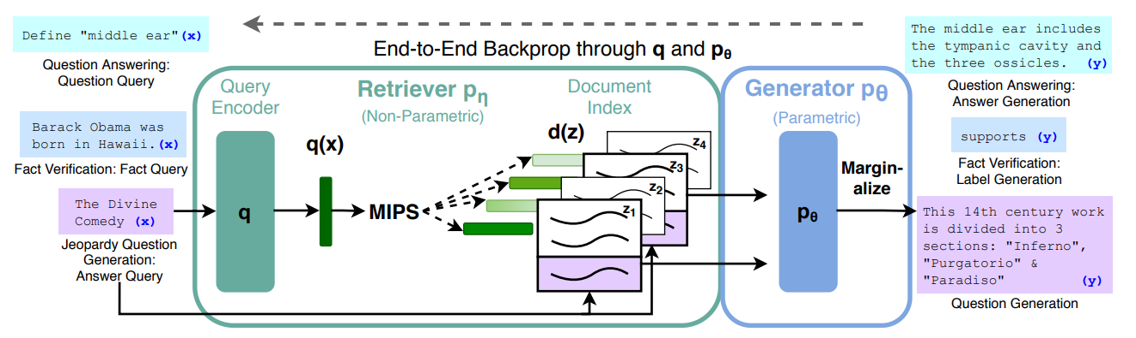
RAG
>
Retrieval-Augmented Generation for Knowledge-Intensive NLP Tasks
Query Encoder : DPR Query Encoder
Passage Encoder : DPR Passage Encoder
Generator : BART Large

Slide 17
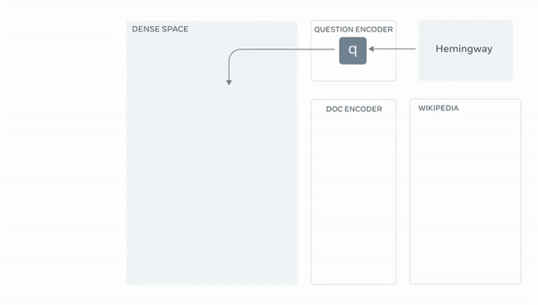
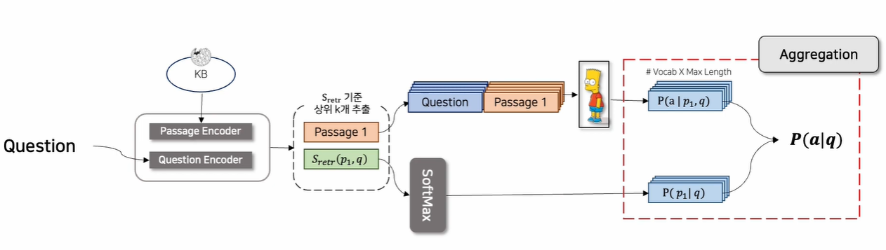
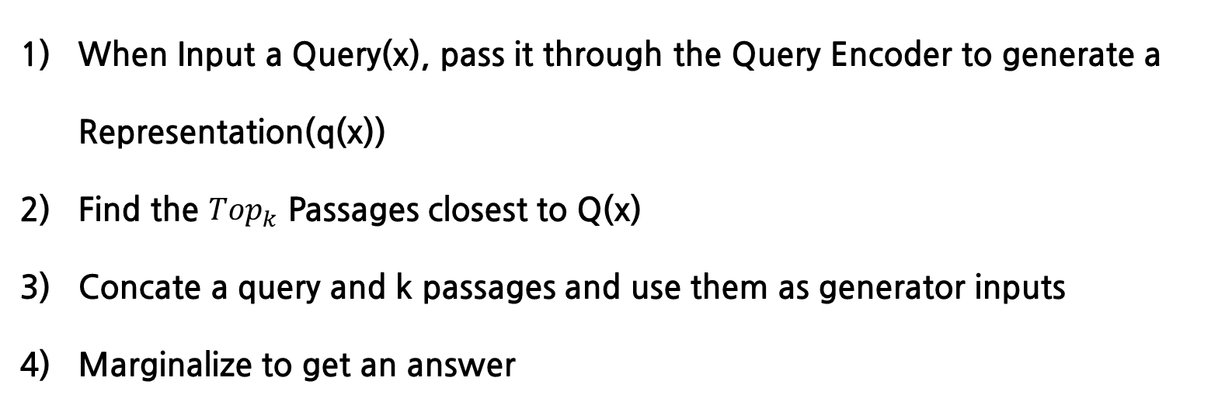
RAG
>
Retrieval-Augmented Generation for Knowledge-Intensive NLP Tasks
When Input a Query(x), pass it through the Query Encoder to generate a Representation(q(x))
Find the ${Top}_{k}$ Passages closest to Q(x)
Concate a query and k passages and use them as generator inputs
Marginalize to get an answer
https://www.youtube.com/watch?v=gtOdvAQk6YU&t=2282s

Slide 18
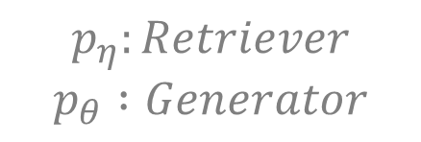
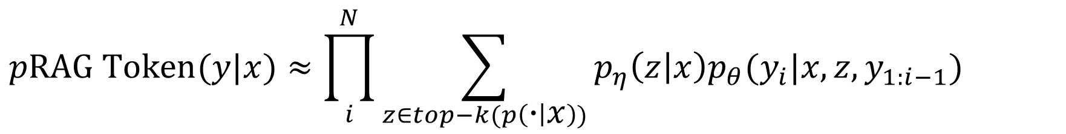
RAG
>
Retrieval-Augmented Generation for Knowledge-Intensive NLP Tasks
1) RAG Token Model
How to Generate Answers While Retrieving a Different Document for Each Target Token
A Model that considers the value of a Document in tokens, marginalizes it, and generates the next token while creating a Sequence.
Use Beam Search
$$pRAG Token(y|x)≈\prod_{i}^{N}{\sum_{z∈top−k(p\left(∙ | x\right))}{p_{η}\left(z | x\right)p_{θ}(y_{i}|x,z,y_{1:i−1})}}$$
$$p_{η}:Retriever$$
$$p_{θ} :Generator$$

Slide 19
Beam Search
>
1) Greedy Search
It
is
raining
Encoder
Decoder
It is raining today
<START>
It
raining
today
What is the weather like today?

Slide 20
Beam Search
>
2) Beam Search
The rainny
The weather is
The weather is humid
The weather
The weather like
The weather is cold
Beam size = 2
The
It like
It is hot
It is raining yesterday
It
It is
It is raining
It is raining today
Encoder
Decoder
It is raining today
The weather is humid
<START>
It
It is
It is raining
What is the weather like today?
The
The weather
The weather is

Slide 21

RAG
>
Retrieval-Augmented Generation for Knowledge-Intensive NLP Tasks
2) RAG Sequence Model
How to select documents that are similar to the initial Query(x), concate each document with Query(x), make a total of K forwards, and then marginalize them.
Modifying Beam Search
$$p_{η}:Retriever$$
$$p_{θ} :Generator$$
$$pRAG Sequence\left(y | x\right)≈\sum_{z∈top−k(p\left(∙ | x\right))}{p_{η}\left(z | x\right)p_{θ}(y|x,z) }=\sum_{z∈top−k(p\left(∙ | x\right))}{p_{η}\left(z | x\right)\prod_{i}^{N}{p_{θ}(y_{i}|x,z,y_{1:i−1})}}$$

Slide 22
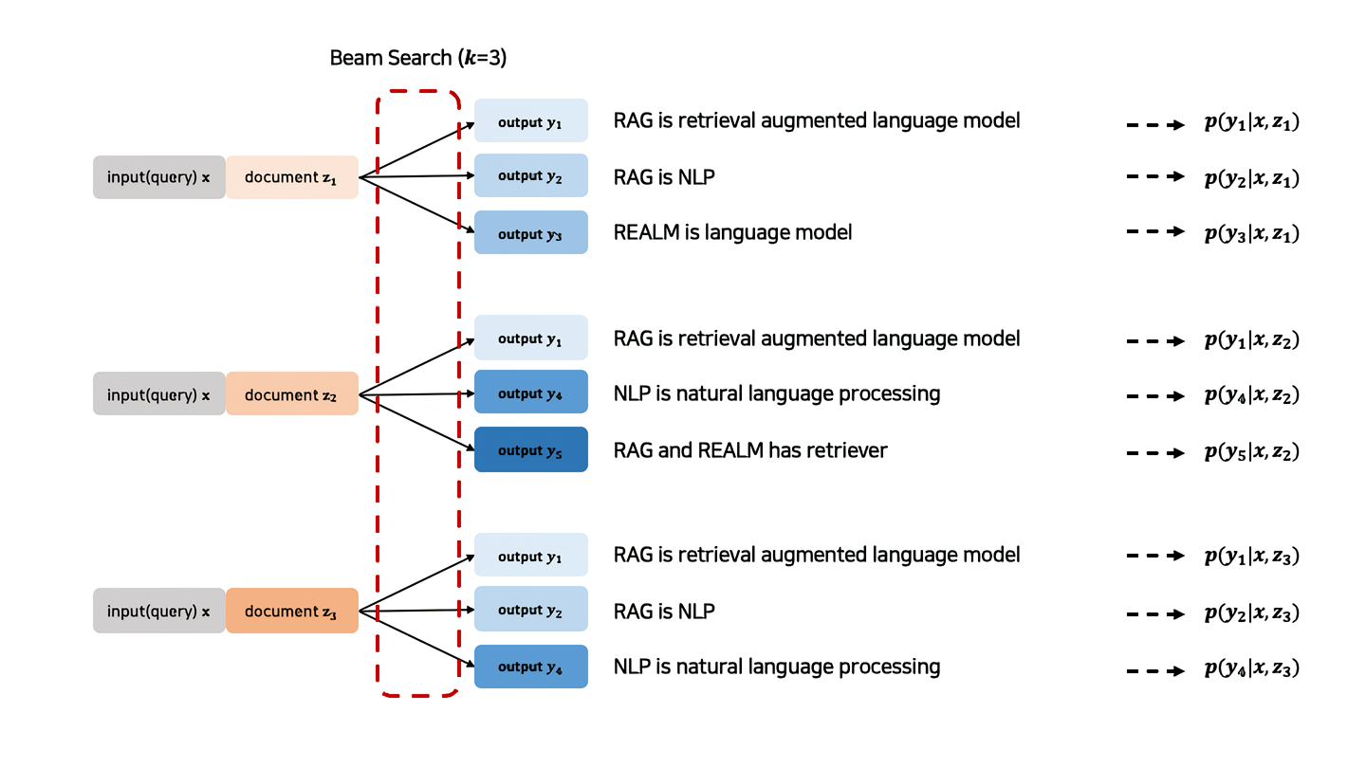
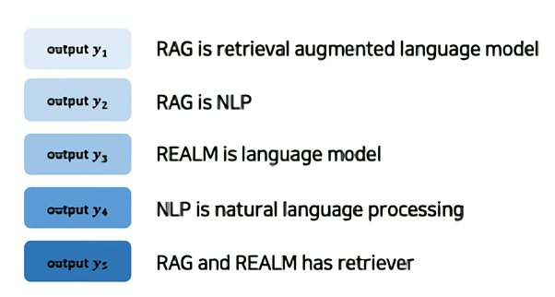
RAG
>
Retrieval-Augmented Generation for Knowledge-Intensive NLP Tasks
2) RAG Sequence Model
https://gbdai.tistory.com/67

Slide 23
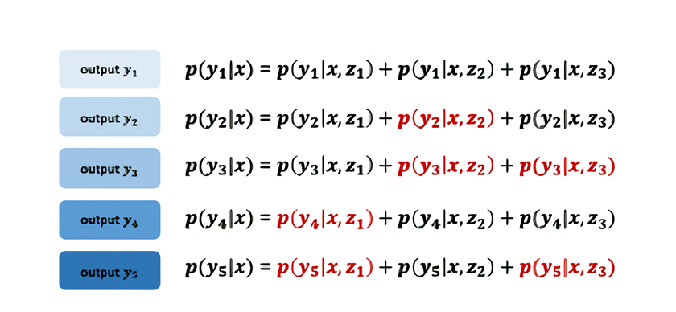
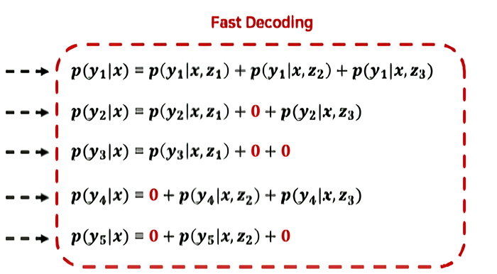
RAG
>
Retrieval-Augmented Generation for Knowledge-Intensive NLP Tasks
2) RAG Sequence Model
Unexplored passages exist during decoding
Treat unexplored passages as 0
https://gbdai.tistory.com/67

Slide 24
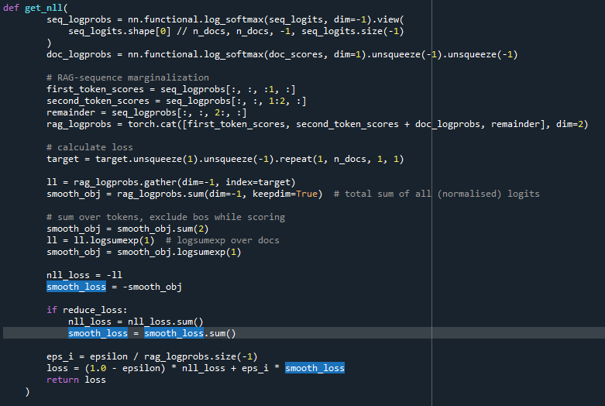
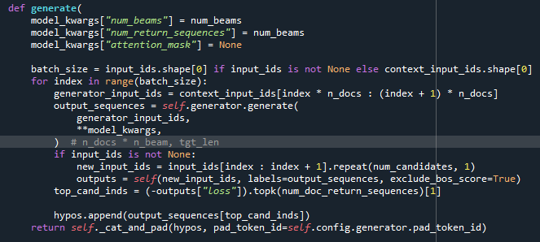
RAG
>
Retrieval-Augmented Generation for Knowledge-Intensive NLP Tasks
https://github.com/huggingface/transformers/blob/v4.20.1/src/transformers/models/rag/modeling_rag.py

Slide 25
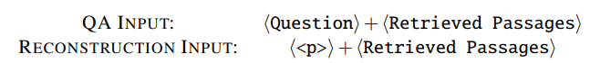
RAG End2End
>
Improving the Domain Adaptation of Retrieval Augmented Generation (RAG) Models for Open Domain Question Answering
연구 목적
기존에 학습된 Wikipedia만이 아닌 우리가 원하는 특정 분야의 도메인에 대한 적응
방안
신경 검색기로 RAG 모델을 미세 조정하고 훈련 중에 지식 인코딩을 비동기적으로 업데이트 하는 방법을 제안
모델이 더 많은 도메인별 지식을 학습할 수 있도록 보조 학습 신호 추가

Slide 26
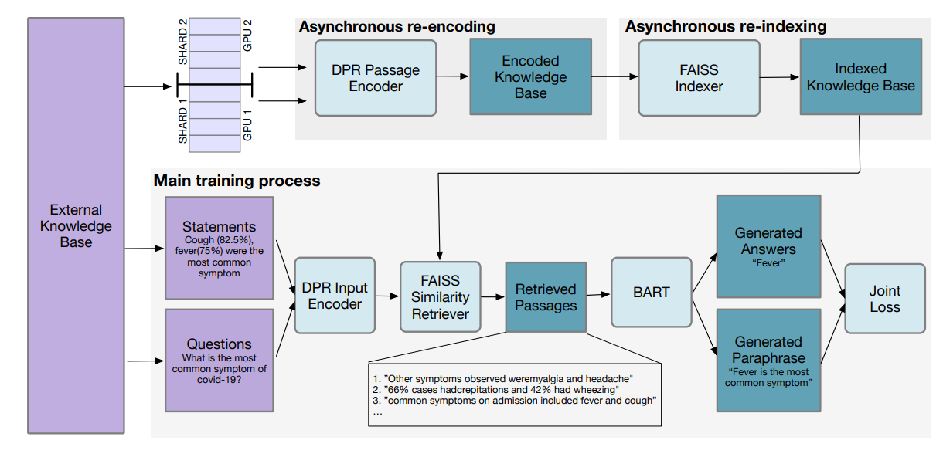
RAG End2End
>
Improving the Domain Adaptation of Retrieval Augmented Generation (RAG) Models for Open Domain Question Answering
Model Architecture

Slide 27
RAG End2End
>
Improving the Domain Adaptation of Retrieval Augmented Generation (RAG) Models for Open Domain Question Answering
Training Framework
Gradient Update를 위한 Main Training Loop
2) Update된 DPR의 Context Encoder로 Knowledge Base Encoding Update 하는 별도의 GPU 사용을 위한 Re-Encoding process
3) FAISS를 사용하여 업데이트된 인코딩으로 Index를 구축
- 두 개의 비동기 프로세스를 사용하여 Main Training Loop에 종속적으로 실행되는 외부
지식 베이스를 Re-Encoding하고 Re-Indexing

Slide 28
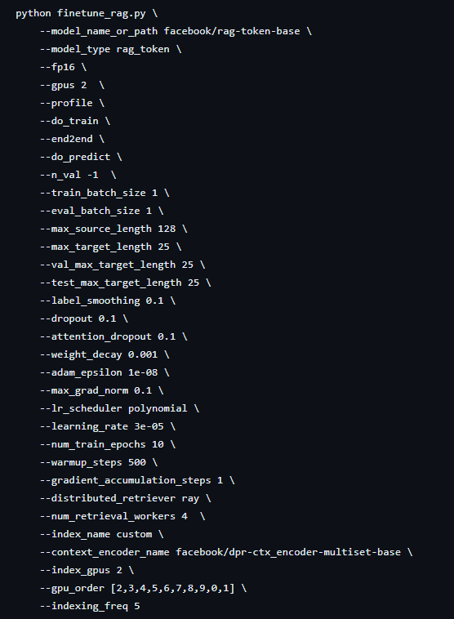
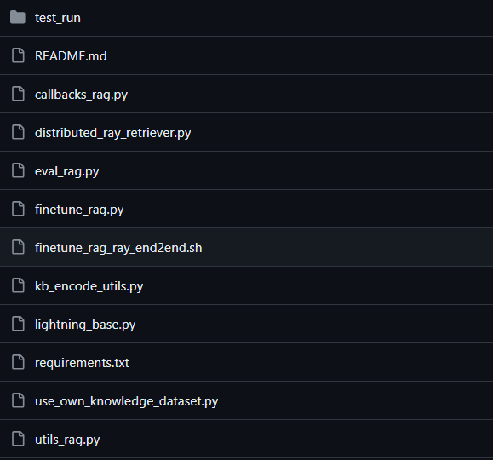
[Rag end2end finetune bash file]
[Rag end2end python file]
Pytorch Lightning

Slide 29
[Rag end2end python file]
Callbacks_rag.py | RAG모델의 학습 및 검증 과정에서 Callback과 Logging 과정을 처리
Distributed_ray_retriever.py | RAG모델의 Retriever 과정을 Ray라는 분산 컴퓨팅 라이브러리를 사용하여 처리
Eval_rag.py | RAG모델의 Retriever part와 Generator part 대한 평가를 진행하며, 예측 결과와 실제 데이터(ground truth)를 비교하여 성능 지표를 계산
Finetune_rag.py | PyTorch Lightning과 Hugging Face의 transformers 라이브러리를 기반으로 RAG모델의 훈련을 위한 클래스와 메소드를 정의
Kb_encode_utils.py | DPR Context Encoder를 사용해 텍스트 데이터의 임베딩을 계산하고, FAISS 인덱스를 통해 임베딩을 효율적으로 검색할 수 있는 구조
Lightning_base.py | RAG모델을 학습시키기 위한 기본 프레임워크를 설정
Use_own_knowledge_dataset.py | RAG모델을 위한 Dataset을 생성하고 인덱싱에 대한 정의
Utils_rag.py | Seq2Seq 데이터셋 처리와 학습 준비, 그리고 평가를 위한 다양한 유틸리티 함수에 대한 정의

Slide 30
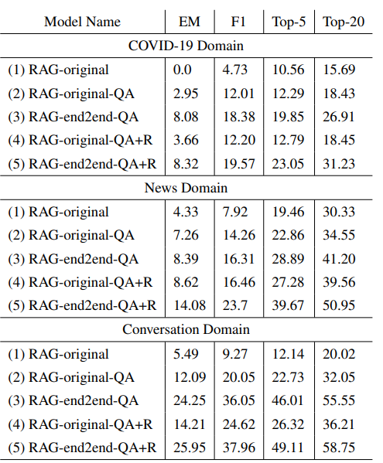
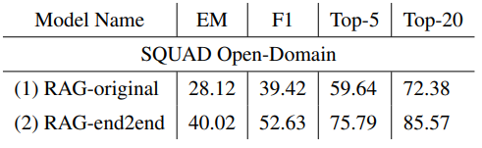
Dataset별 평가 지표

Slide 31
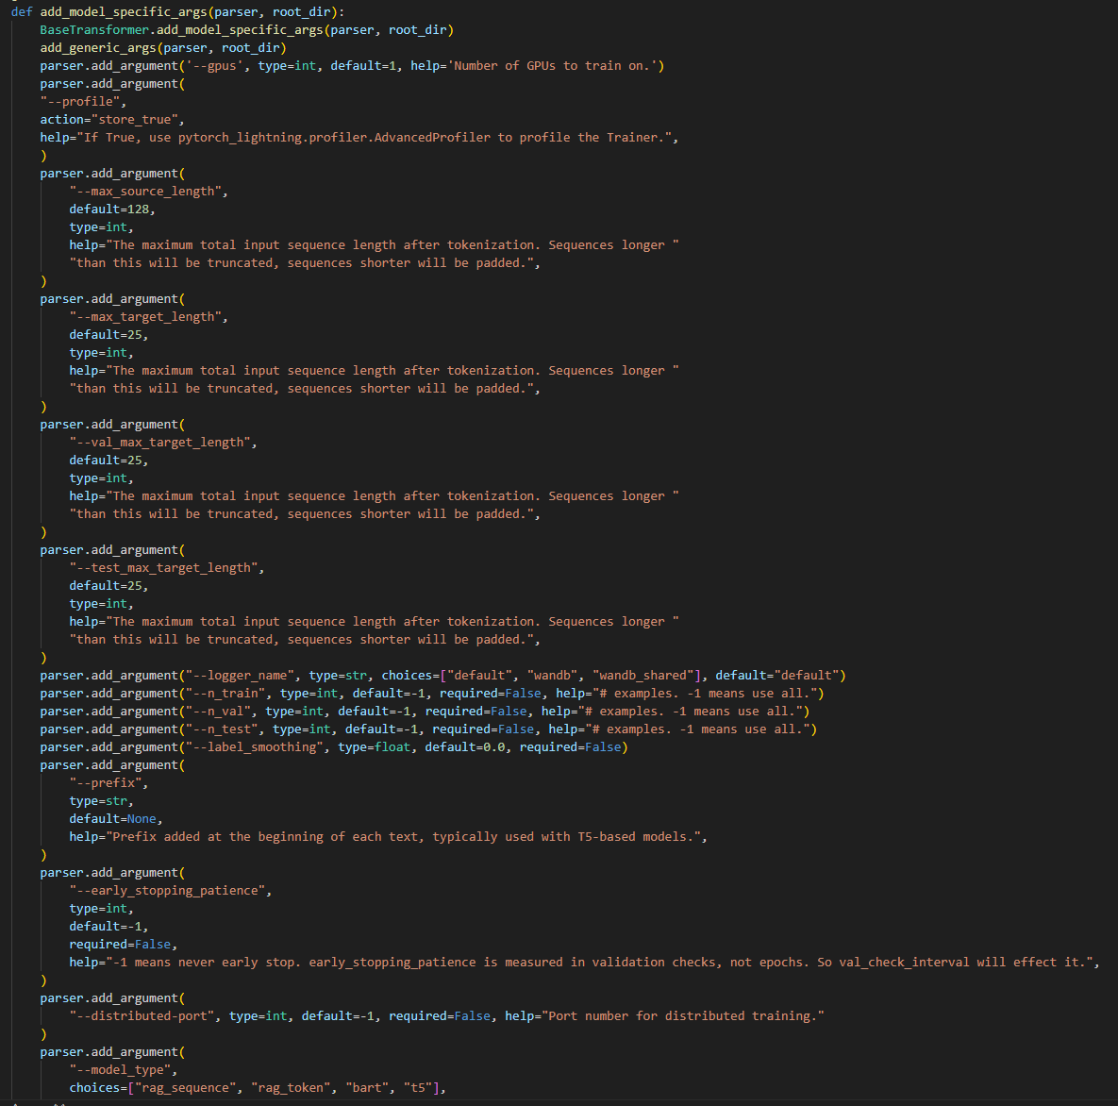
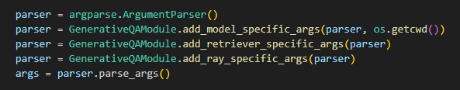
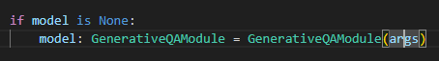
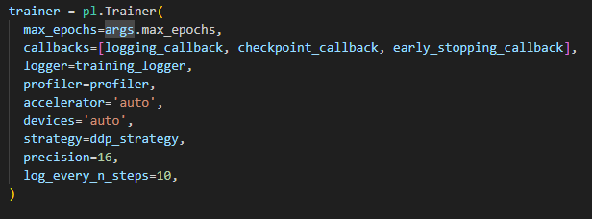
[Pytorch Lightning]

Slide 32
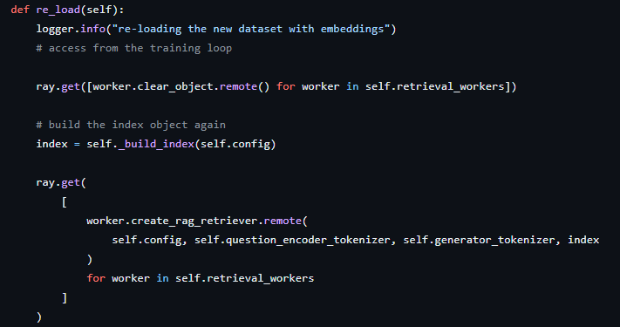
This process ensures that the retrieval component of the RAG-end2end model is using the most current data, enabling it to provide more accurate and relevant information in response to queries

Slide 33
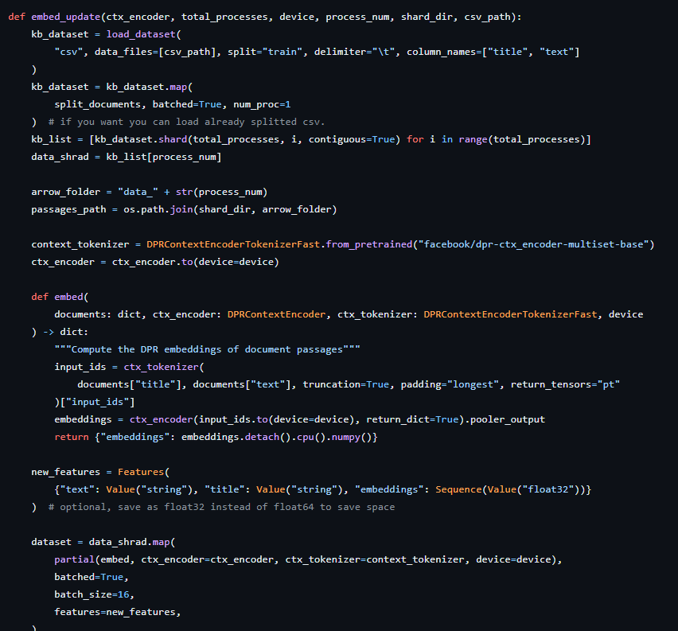
Asynchronous Re-encoding
This part involves using separate GPUs to divide the workload (as shown by SHARD 1 and SHARD 2)
Each shard encodes parts of the external knowledge base using the DPR Passage Encoder
This updated encoding reflects the latest information and model adjustments

Slide 34
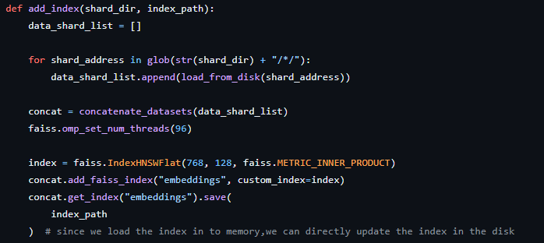
Asynchronous Re-indexing
Once the knowledge base is re-encoded, the FAISS Indexer builds a new index from this updated encoding
This index enables efficient retrieval of passages relevant to the input question or statement

Slide 35
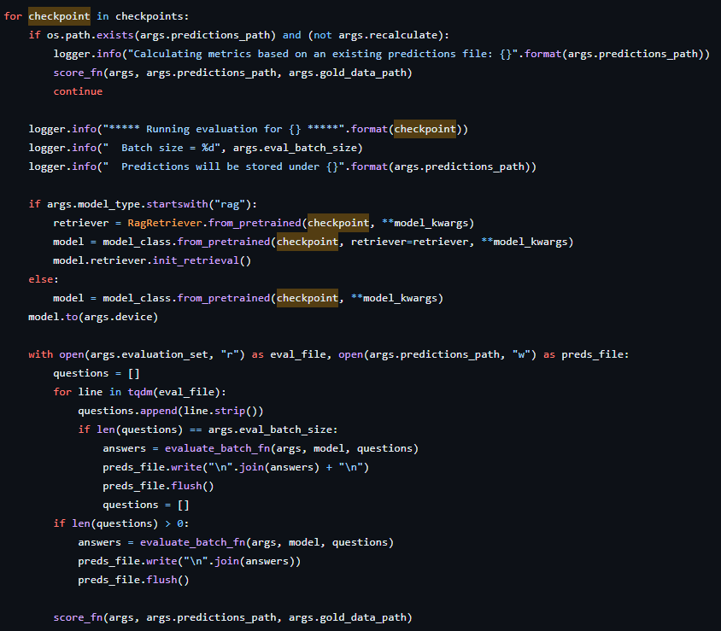
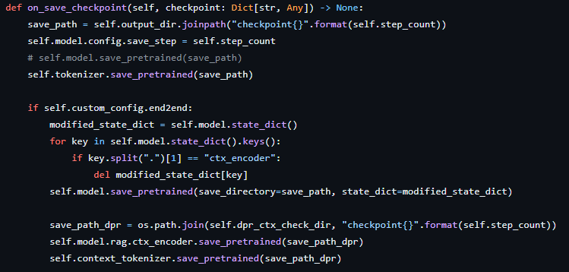
Use model checkpoints to make predictions on an evaluation dataset, compute and record the results, and record the results

Slide 36
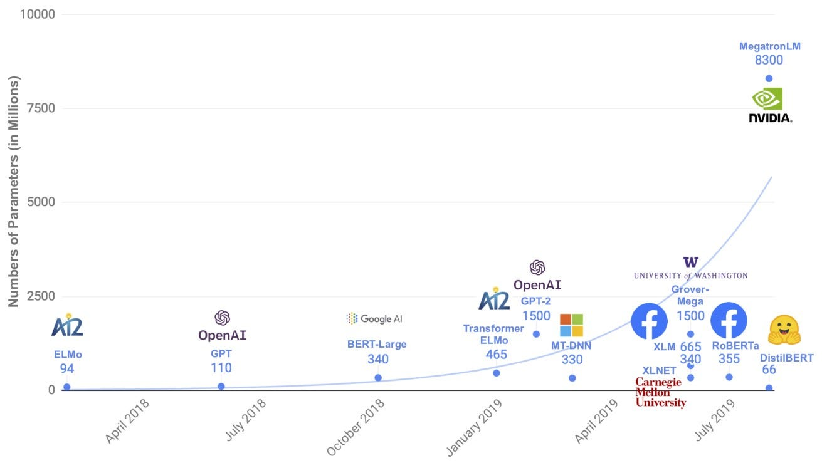
Problem Statement
>
PEFT
By freezing most of the parameters of the pre-trained LLM and fine-tuning only a few parameters, this method significantly reduces storage and computational power.
RAG
Retriever : Two Bert(110M)
Generator : Bart-Large(406M)

Slide 37
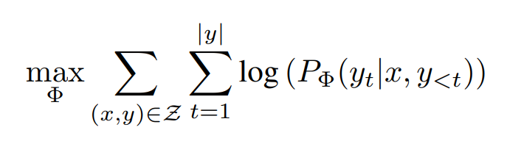
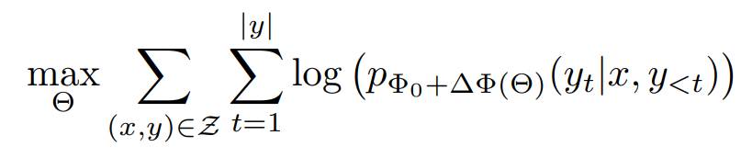
LoRA
>
Low-Rank Adaptation of Large Language Models
Fully Finetuning
Gradient with Backpropagation
The previously recorded Optimizer state
Memory to hold the Model
Memory overload
Lora
Freeze the pretrained parameter and calculate the change in the parameter corresponding to ∅.

Slide 38
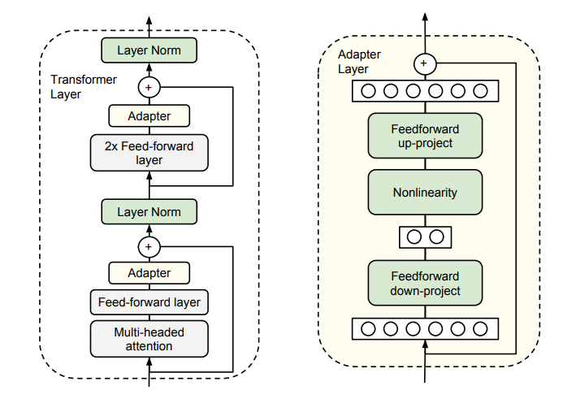
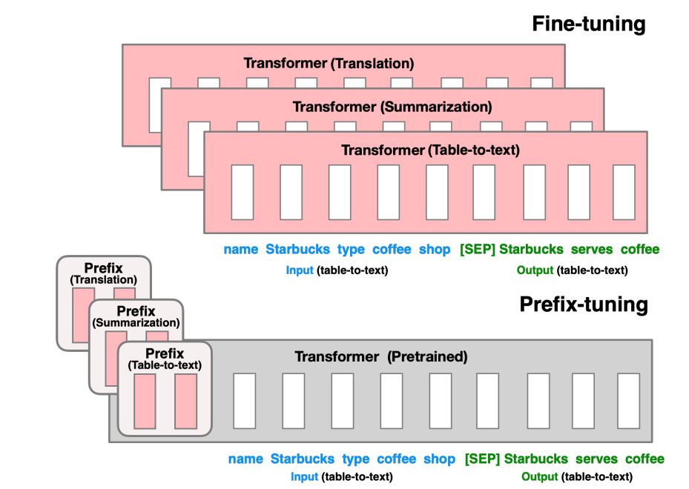
LoRA
>
Low-Rank Adaptation of Large Language Models
Adapter Tuning
Parameter-efficient transfer learning for NLP
N Houlsby et al., 2019
Add learnable parameters per task to each transformer layer of BERT
Significant increase in Inference latency
Prefix Tuning
Optimizing continuous prompts for generation
XL Li et al., 2021
Inserts a prefix token into the input sequence of query, key, and value
Difficult to optimize because performance varies non-monotonically with the trainable parameter
Reduces the sequence length available for processing downstream tasks

Slide 39

LoRA
>
Low-Rank Adaptation of Large Language Models
Suppose
Over parameterized model is actually based on a Low Intrinsic Dimension
Intrinsic dimensionality explains the effectiveness of language model fine-tuning
Aghajanyan et al., 2020
Advantages
Reduces storage requirements and task-switching overhead by only having to switch LoRA modules depending on the task
Can be applied to any Dense layer
No additional inference latency
The size of A,B is smaller than W, which can reduce the time and computational cost by up to 3 times.

Slide 40


LoRA
>
Low-Rank Adaptation of Large Language Models
Approximate the change in Weight through Rank Decomposition matrices
Freeze $W_{0}$and Training only $A,B$
Multiply the input x and sum the output vectors in a coordinate-wise
Added to sum $W_{0}$ to form a new weight $W$ for the model

Slide 41


Define LoraA, LoraB
LoraA is initialized with kaiming_uniform
LoraB is initialized as a 0 vector matrix
Update weights with only LoraA and LoraB
No Additional inference latency

Slide 42


LoRA
>
Low-Rank Adaptation of Large Language Models
NLU & NLG Task

Slide 43


LoRA
>
Low-Rank Adaptation of Large Language Models

